Slide 1
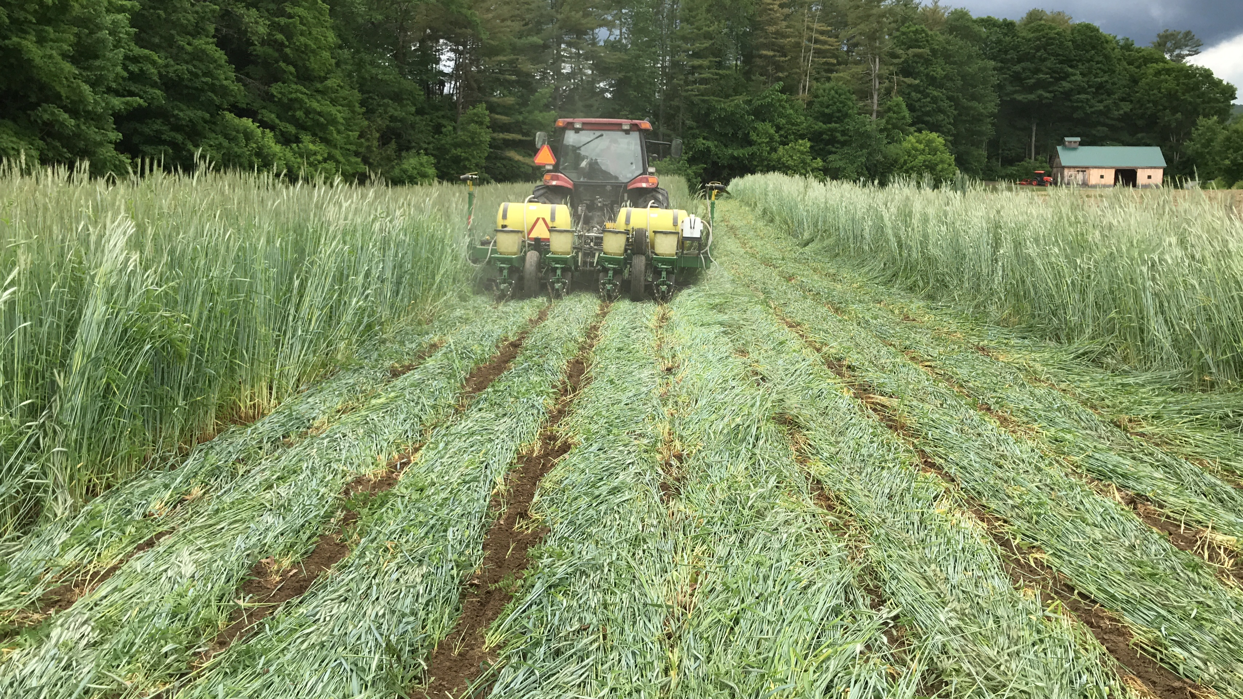
Termination Strategies

Slide 2
Learning Objectives
Determine how you plan to terminate a cover crop.
Describe the types of termination methods available
    Physical, chemical or biological
Evaluate herbicide strategies to terminate multiple plant functional groups.
Analyze NRCS Termination Guidelines.

Slide 3

Policy
State FOTG 340
National Bulletin 190-16-8 ECS – Exclusion of Buckwheat in Conservation Planting in or Near Commodity Wheat fields in Selected West and Central States. This is expired
  CO, ID, KS, MN, MT, NE, ND, SD, OR, WA, and WY
  No buckwheat within next 2 calendar years in rotation or adjacent to wheat fields
Notes:
Adjacent is 30 feet. So a buffer is needed.
General recommendation is 1 year NRCS was conservative and went with 2 years
IF expired then do we still follow the NB? if expired why do we still need to talk about it?????

Slide 4
When should you plan to terminate a cover crop?
Before planting

Slide 5
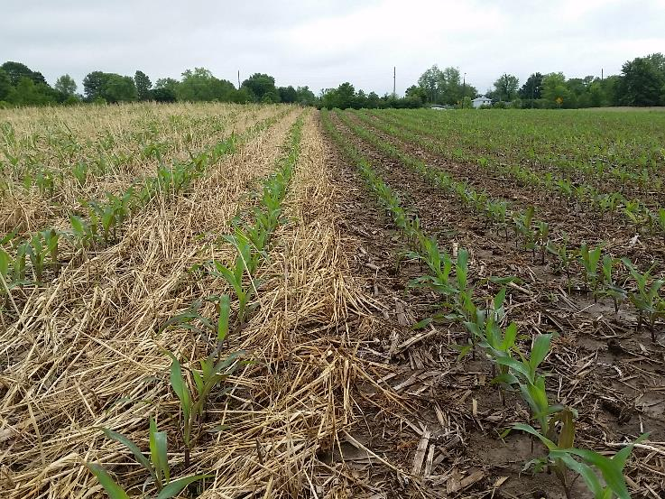
COVER CROP Termination
Have a good GAME PLAN…
  What are your goals?
Be adaptive to the season
  Wet springs happen!
Notes:
Examples-being able to spray in wet conditions, ? Dry conditions- cover using available moisture? Goals: weed suppression? Nutrient cycling? Increase OM? Residue armor cover? Increased infiltration? Biofumigant-Nematode suppression? Reduced evaporation loss? C:N ratio- cover maturity?

Slide 6
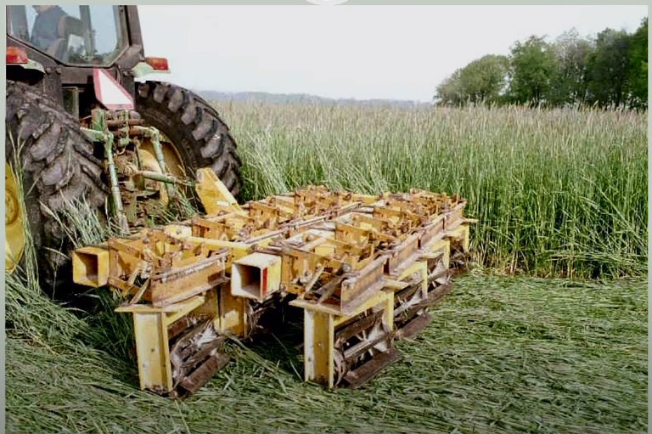
Termination Methods
Tillage
Rolling/Crimping
Mowing
Tarping/Solarization
Grazing
Winterkill
Herbicides
Physical
Biological
Chemical
Combination of Methods
Notes:
Does Grazing truly kill the intended cover?- Most generally not, but depends on timing and mix. If you have grazed it hard enough to kill it- did you leave enough to cover the soil? May suppress growth until winterkill however

Slide 7
Choosing Termination Method
What is your objective?
What is your planting/growing window?
What is your cropping system?
What is your tolerance for weed escapes?
What is your climate/ weather? dry or wet?
Management system- organic /conventional?, No-till?
Is green bridge or allelopathic effects a concern?
Notes:
Find a good paper on Green bridge.
Use of drones on wet fields

Slide 8
Tillage
Pros:
Can be used in Organic systems.
Very effective at killing cover.
Rapid nutrient release.
Necessary in biofumigant situations.
Cons:
High disturbance will negatively affect habitat. of the microbiology and aggregate stability.
Loosening of soil stability can lead to erosion issues.
Bare fields.
Notes:
Herbicides are a disturbance too- Depending on management and objectives tillage is still a tool available. In order for glucosinolates or similar compounds to work as a biofumigant to control nematodes they must be broken down and chopped and incorporated into soil. Principle is Minimize Disturbance- all kinds of disturbance not 0 disturbance.

Slide 9
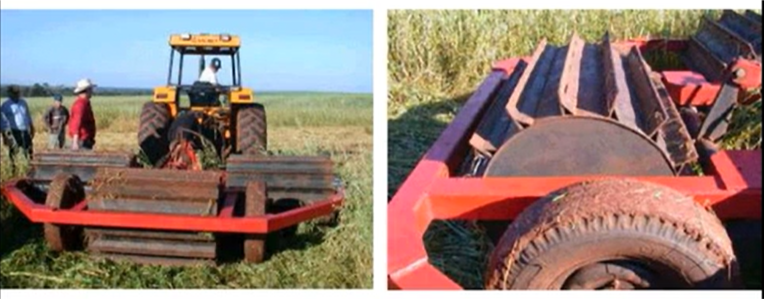
Rolling/Crimping
Pros:
Works for “planting green” scenarios
Minimizes disturbances
Works in Organic and No-till systems
Increases cover and residue on soil surface
Can choose to also incorporate herbicide into the rolling operation?
Notes:
Herbicide can work either before or after rolling operation- may get better coverage if sprayed before. There are multiple ways to combine spraying and rolling/crimping with bars or spray nozzles mounted on either front or back of tractor. NEED Nathan’s picture
Not sure that a cover crop roller crimper will incorporate herbicide? mw

Slide 10
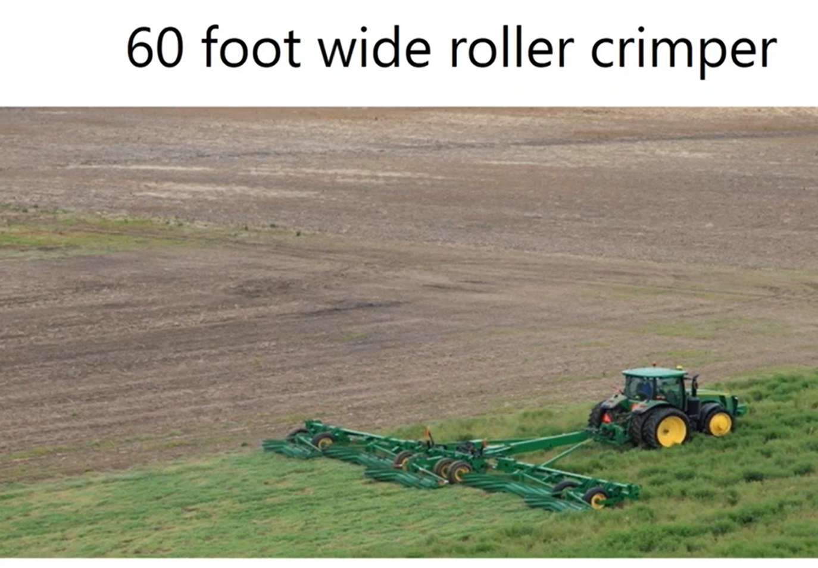
Rolling/Crimping
Considerations:
Timing is tricky to get good kill- may have to wait on plant maturity (flowering).
May have less available Nitrogen.
Crops can “wrap” around moving parts- may need adaptations.
Need to plant same direction that it was rolled.
Notes:
If rye is mature then watch temperature gauge as pollen/seedheads can clog filters and air intakes. May take More Nitrogen to decompose mature crop that was rolled due to increased C:N ratio. If don’t plant in same direction it was rolled it may ball up under planter- areas that are prone to lodging may find this difficult.
Many producers around the US are using roller crimpers very effectively, when plant conditions are terminated correctly

Slide 11
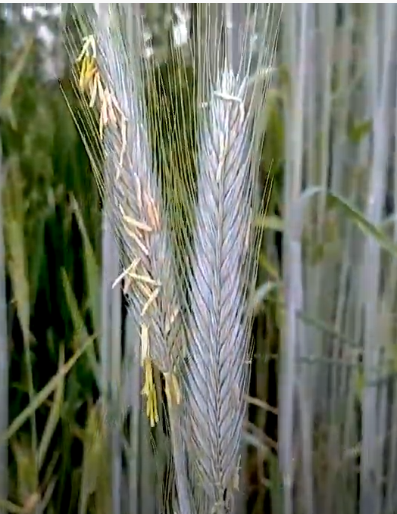
Timing is critical
Rolling/Crimping
Maturity important factor of when covers can be terminated with Crimping
  Cereal Rye- Rye is most susceptible to crimping starting at the flowering stage
  (19) Rye Termination Timing: When to Successfully Crimp - YouTube
Notes:
Stages of Rye maturity and timing - Video = 2.59 min Timing will also be affected if you plan to use Herbicides or not

Slide 12
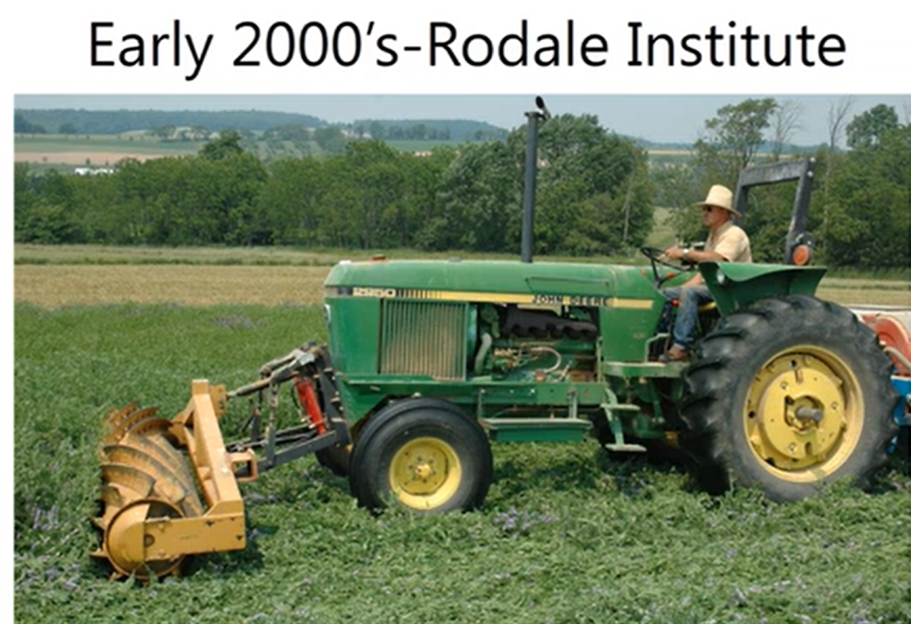
Rolling/Crimping Considerations
Managing multiple species and high biomass
Cover crop seeding rates
Is there a need to make sure the cover is actually flat or is standing dead okay?
(19) What is the Best Way to Terminate a Cover Crop? - YouTube
Notes:
Video = 4.38 min Factors affecting lodging: seeding rate, Nitrogen availability, mix ratio of Legumes, wind/rain storms

Slide 13
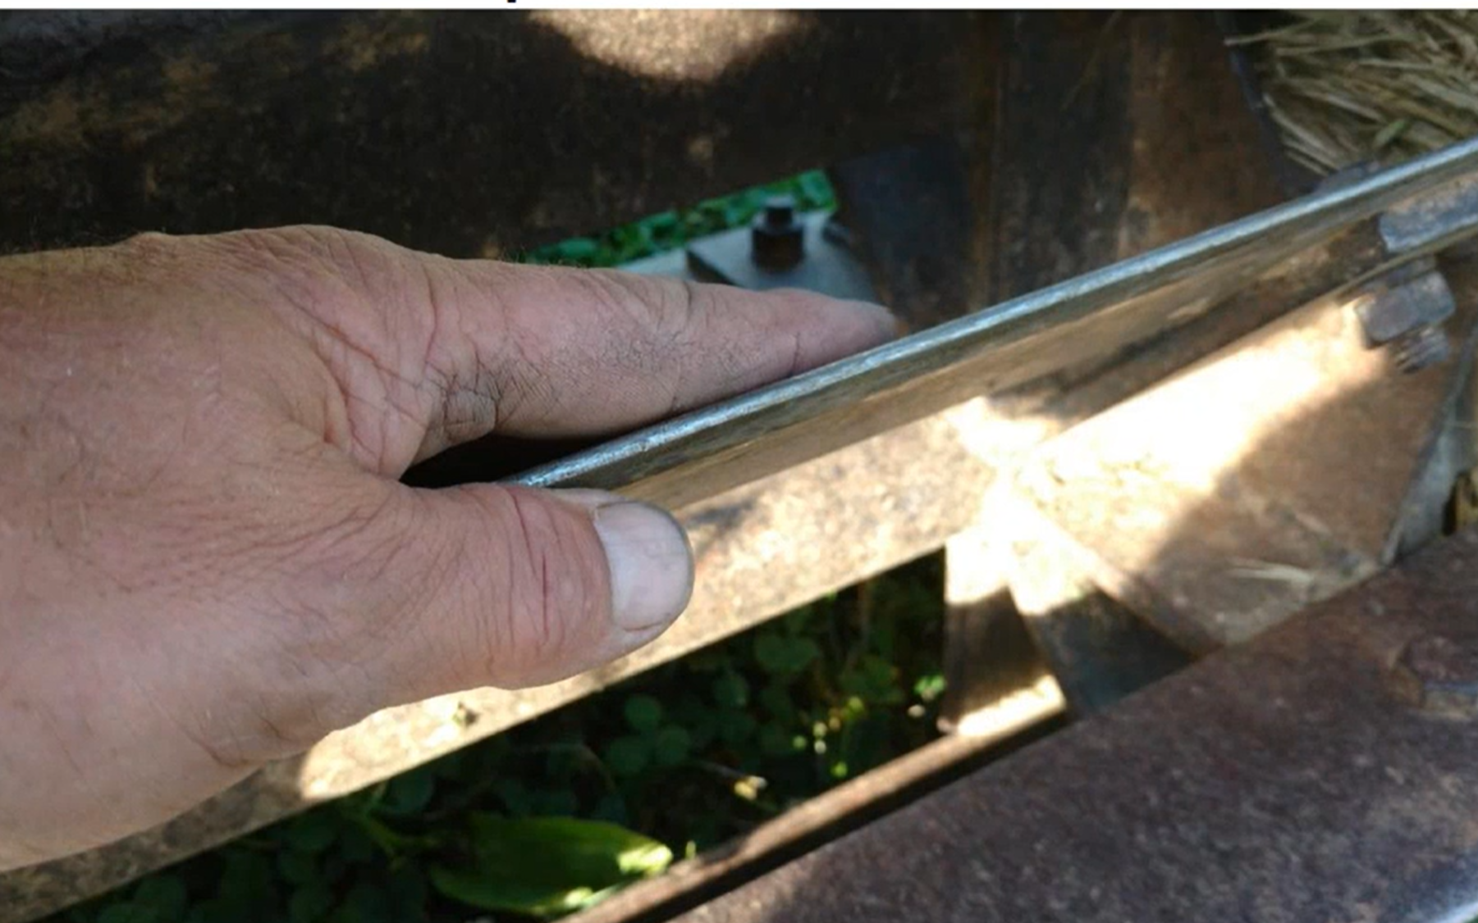
Rolling/Crimping
Want cover to be Crimped not cut. If cover species are cut they have opportunity to regrow- or secondary growth. So, the blades need to be dull not sharp.

Slide 14
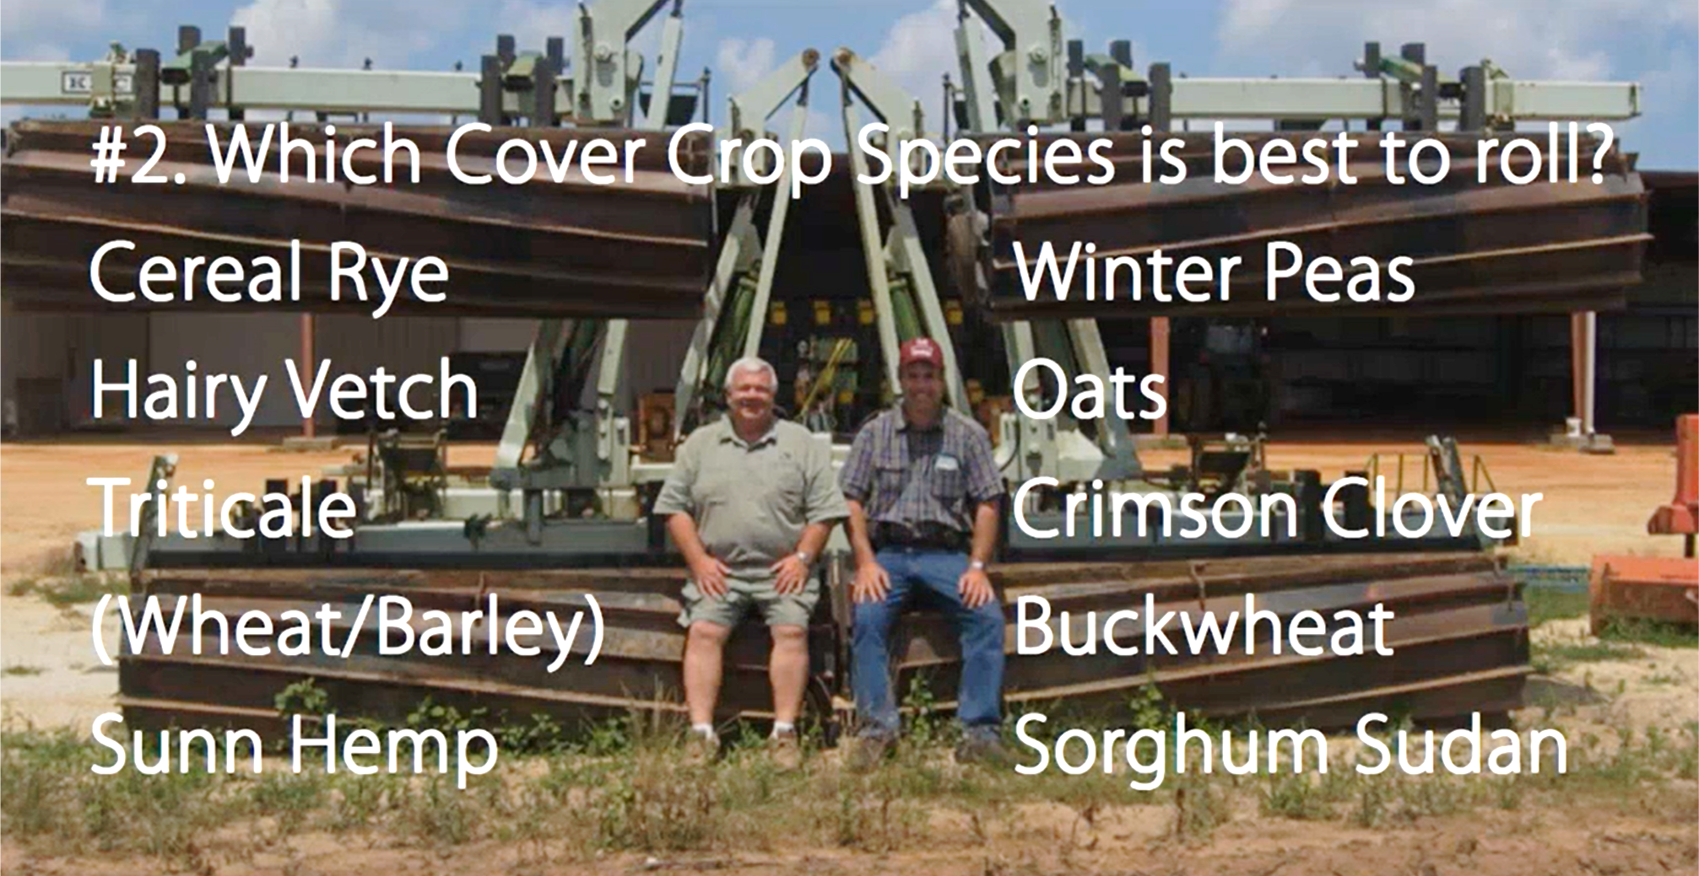
Rolling/Crimping
Notes:
On the Left are the most popular to roll. Sorghum Sudan will grow back. Rye & vetch as a mix are controlled better than the Rye as a monoculture- not sure why this occurs.
Photo: picture of howard buffet and his operator

Slide 15
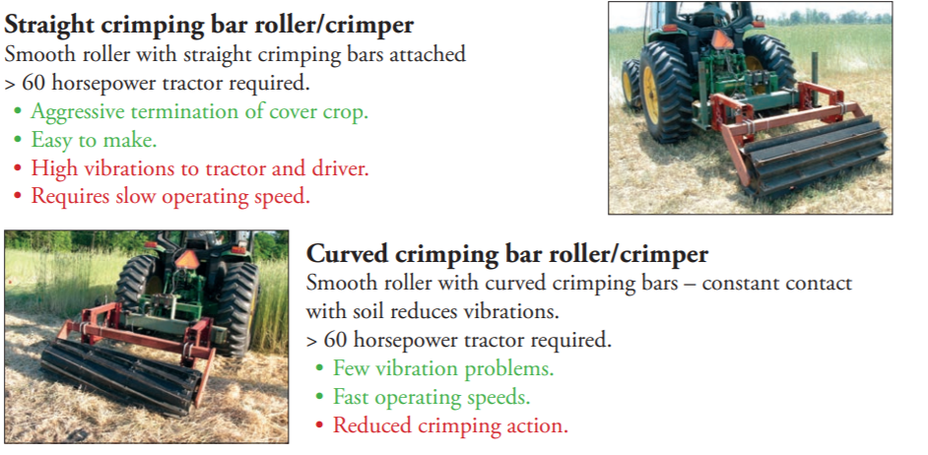
Rolling/Crimping
Types of Rollers- Pros & Cons
ARS- Conservation Systems Research Fact sheet #7
https://southerncovercrops.org/wp-content/uploads/2018/02/Rollers-for-Terminating-07.pdf
Notes:
Print out reference as a handout.

Slide 16
Mowing
Pros:
Can successfully kill a plant in the broadleaf category or a with a terminal seedhead.
Relatively inexpensive
Organic alternative
Sizes residues
Cons:
Flail mower better than rotary
Must be done at flowering
May not kill plant totally i.e. sorghum/sudan
Warmer states may see rapid residue turnover.
May adversely affect planter performance (push small pieces in planter V and dragging)
Notes:
Another mechanical option for cover crop termination is mowing after the flowering stage. Flail mowers are preferred over rotary mowers because the residues are evenly distributed and are more uniform in length. Mowing terminates the crop quickly, but it is energy intensive and there is a possibility for regrowth depending on the species and time of termination.

Slide 17
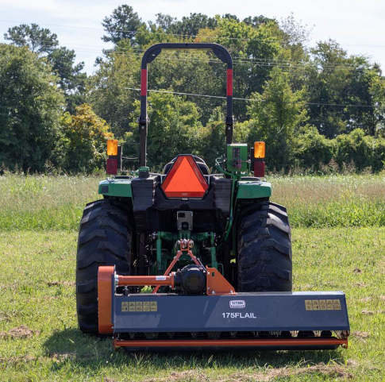
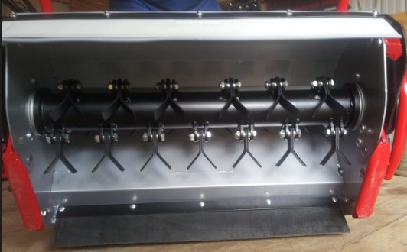
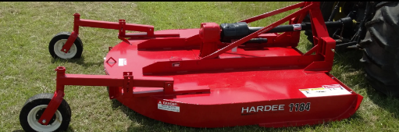
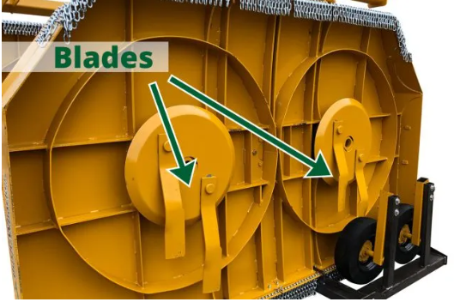
Mowing
Flail mower
  Lifts and lowers after cutting so good even distribution of residue
Rotary mower
  Places residue in a wind row so less coverage across the field.

Slide 18
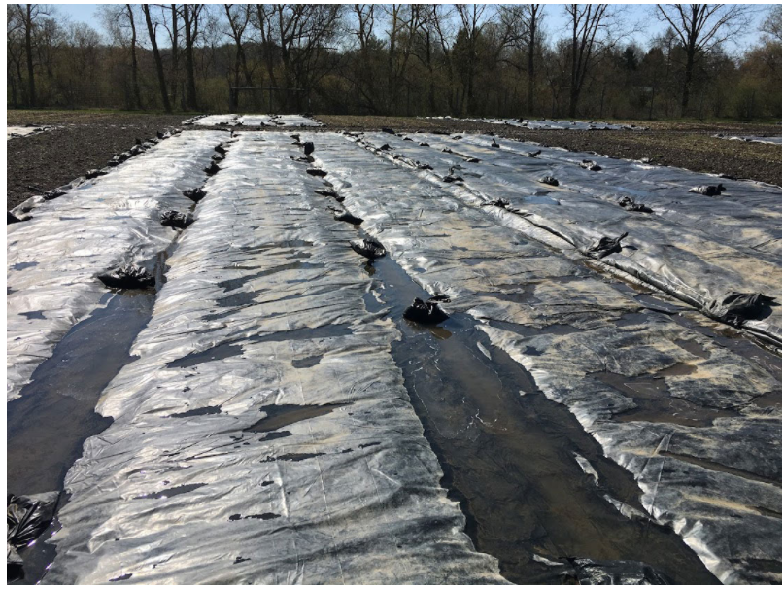
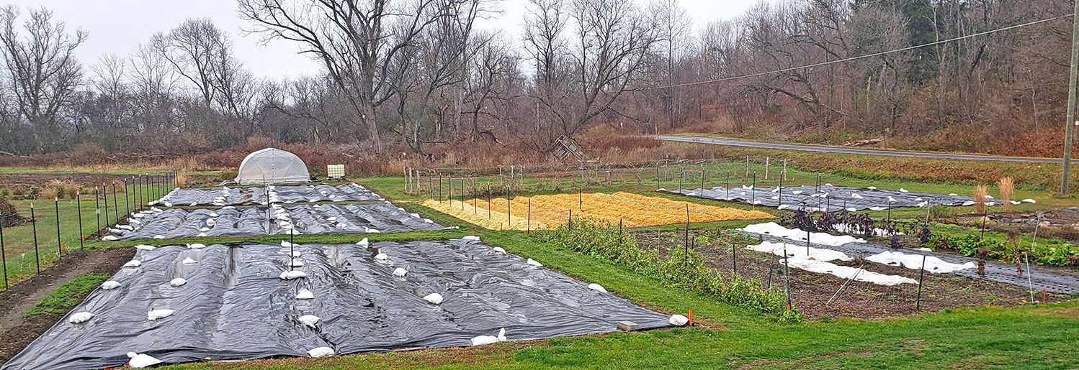
Tarping/Solarization
Photo: Cornell Thompson Vegetable Research Farm in Freeville, NY. Ryan Maher.
Pros:
Reduces the need for tillage and chemicals
Different objectives can be met using different color tarps
Cons:
Not practical on a large scale
Runoff concerns
Management intensive to move, layout, and remove and disposal
Some material restrictions, if organic
Tarps covering beds and integrated into the field planning at Centurion Farm. Photo: Nina Saeli.
Notes:
Is this to kill weeds or to terminate cover crops? mw
Need notes about color tarps

Slide 19
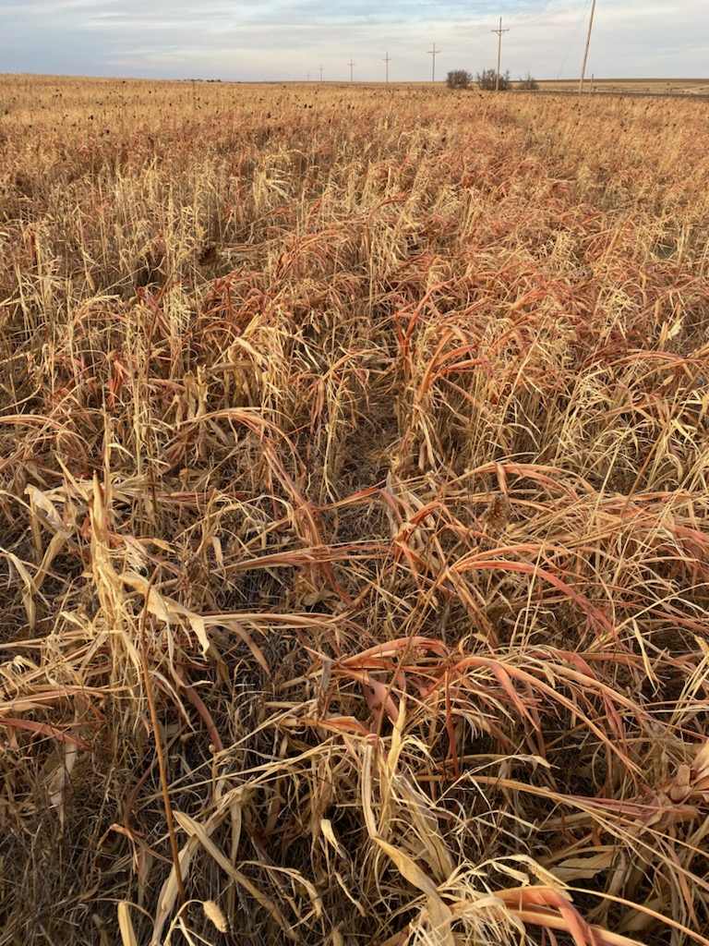
Winterkill/Frost Termination
Pros:
Easy to plant in the Spring or summer
No cost
No labor
Requires no additional equipment
No chemical footprint
Depending on species may be less carbon/residue in spring than other termination methods?
Notes:
Easy to plant in spring because the cover has already started to decompose and allows for ability to choose timing and species for next crop or cover. Less residue in the spring may be a Pro or Con depending on your management and timing of planting subsequent crop. Photo: Sorghum-Sudan, German Millet, Sunflower, Brassica Mix planted in August. Frost killed in Mid-October (Western KS)
In spring time producer may have to spray a few weeds before planting
Leaves cc growing for maximum time

Slide 20
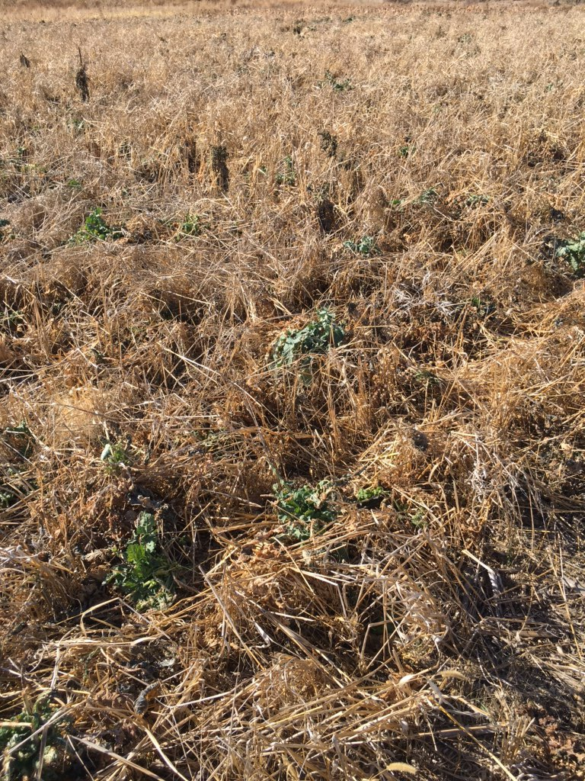
Winterkill
Cons:
Never know when it’s going to freeze- can freeze too early, too late? or not at all
Not all species die at same temperature
Not all climates are good for frost termination
May not leave as much residue as other methods?
Generally cool season species that don’t winter kill – Low C:N?
Notes:
Photo-Kale, and other Brassicas did not terminate when main warm season grass species frost killed. Early frost limits photosynthesis time available depending on the mix.
We have to look at these 2 slides

Slide 21
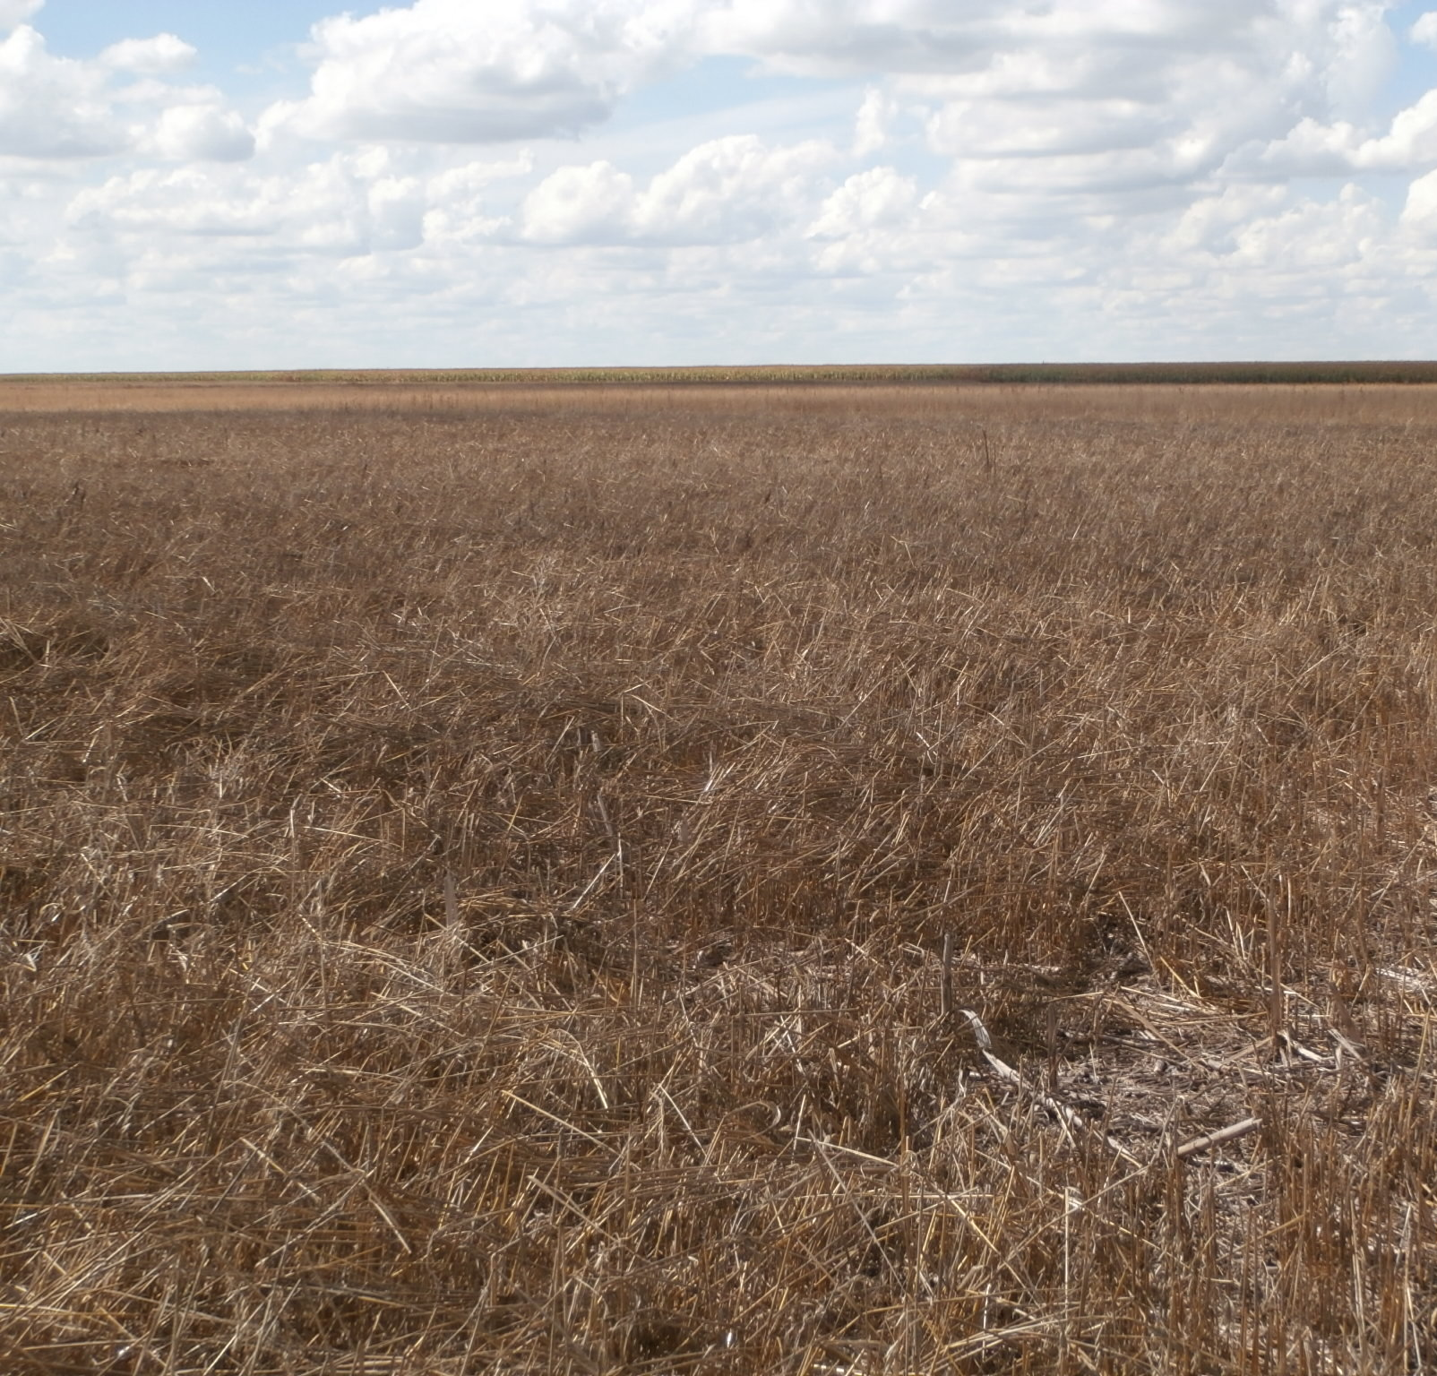
Herbicide
Pros:
Generally easy to get a consistent kill when cover is immature or actively growing
Can terminate covers at any growth stage- killing covers prior to seed production is more water efficient
Dead plant residue is still covering soil
Field is ready to plant without additional disturbance
Notes:
Spring cover (oats, barley, Pea, brassica multi species mix) Planted in April terminated in June and ready to plant to winter wheat in the fall (Sept). Management decision to Spray in June prior to flowering in order to save Moisture (Western KS). Allowing plants to go to flowering uses more moisture as plants translocate moisture and nutrient to seed heads as they begin to form. Presenter can change photo to be representative of their area. Generally in No-till situations this fallow period before winter wheat there are already several spray operations, with a cover crop many times there is only 1 spray required to terminate cover

Slide 22
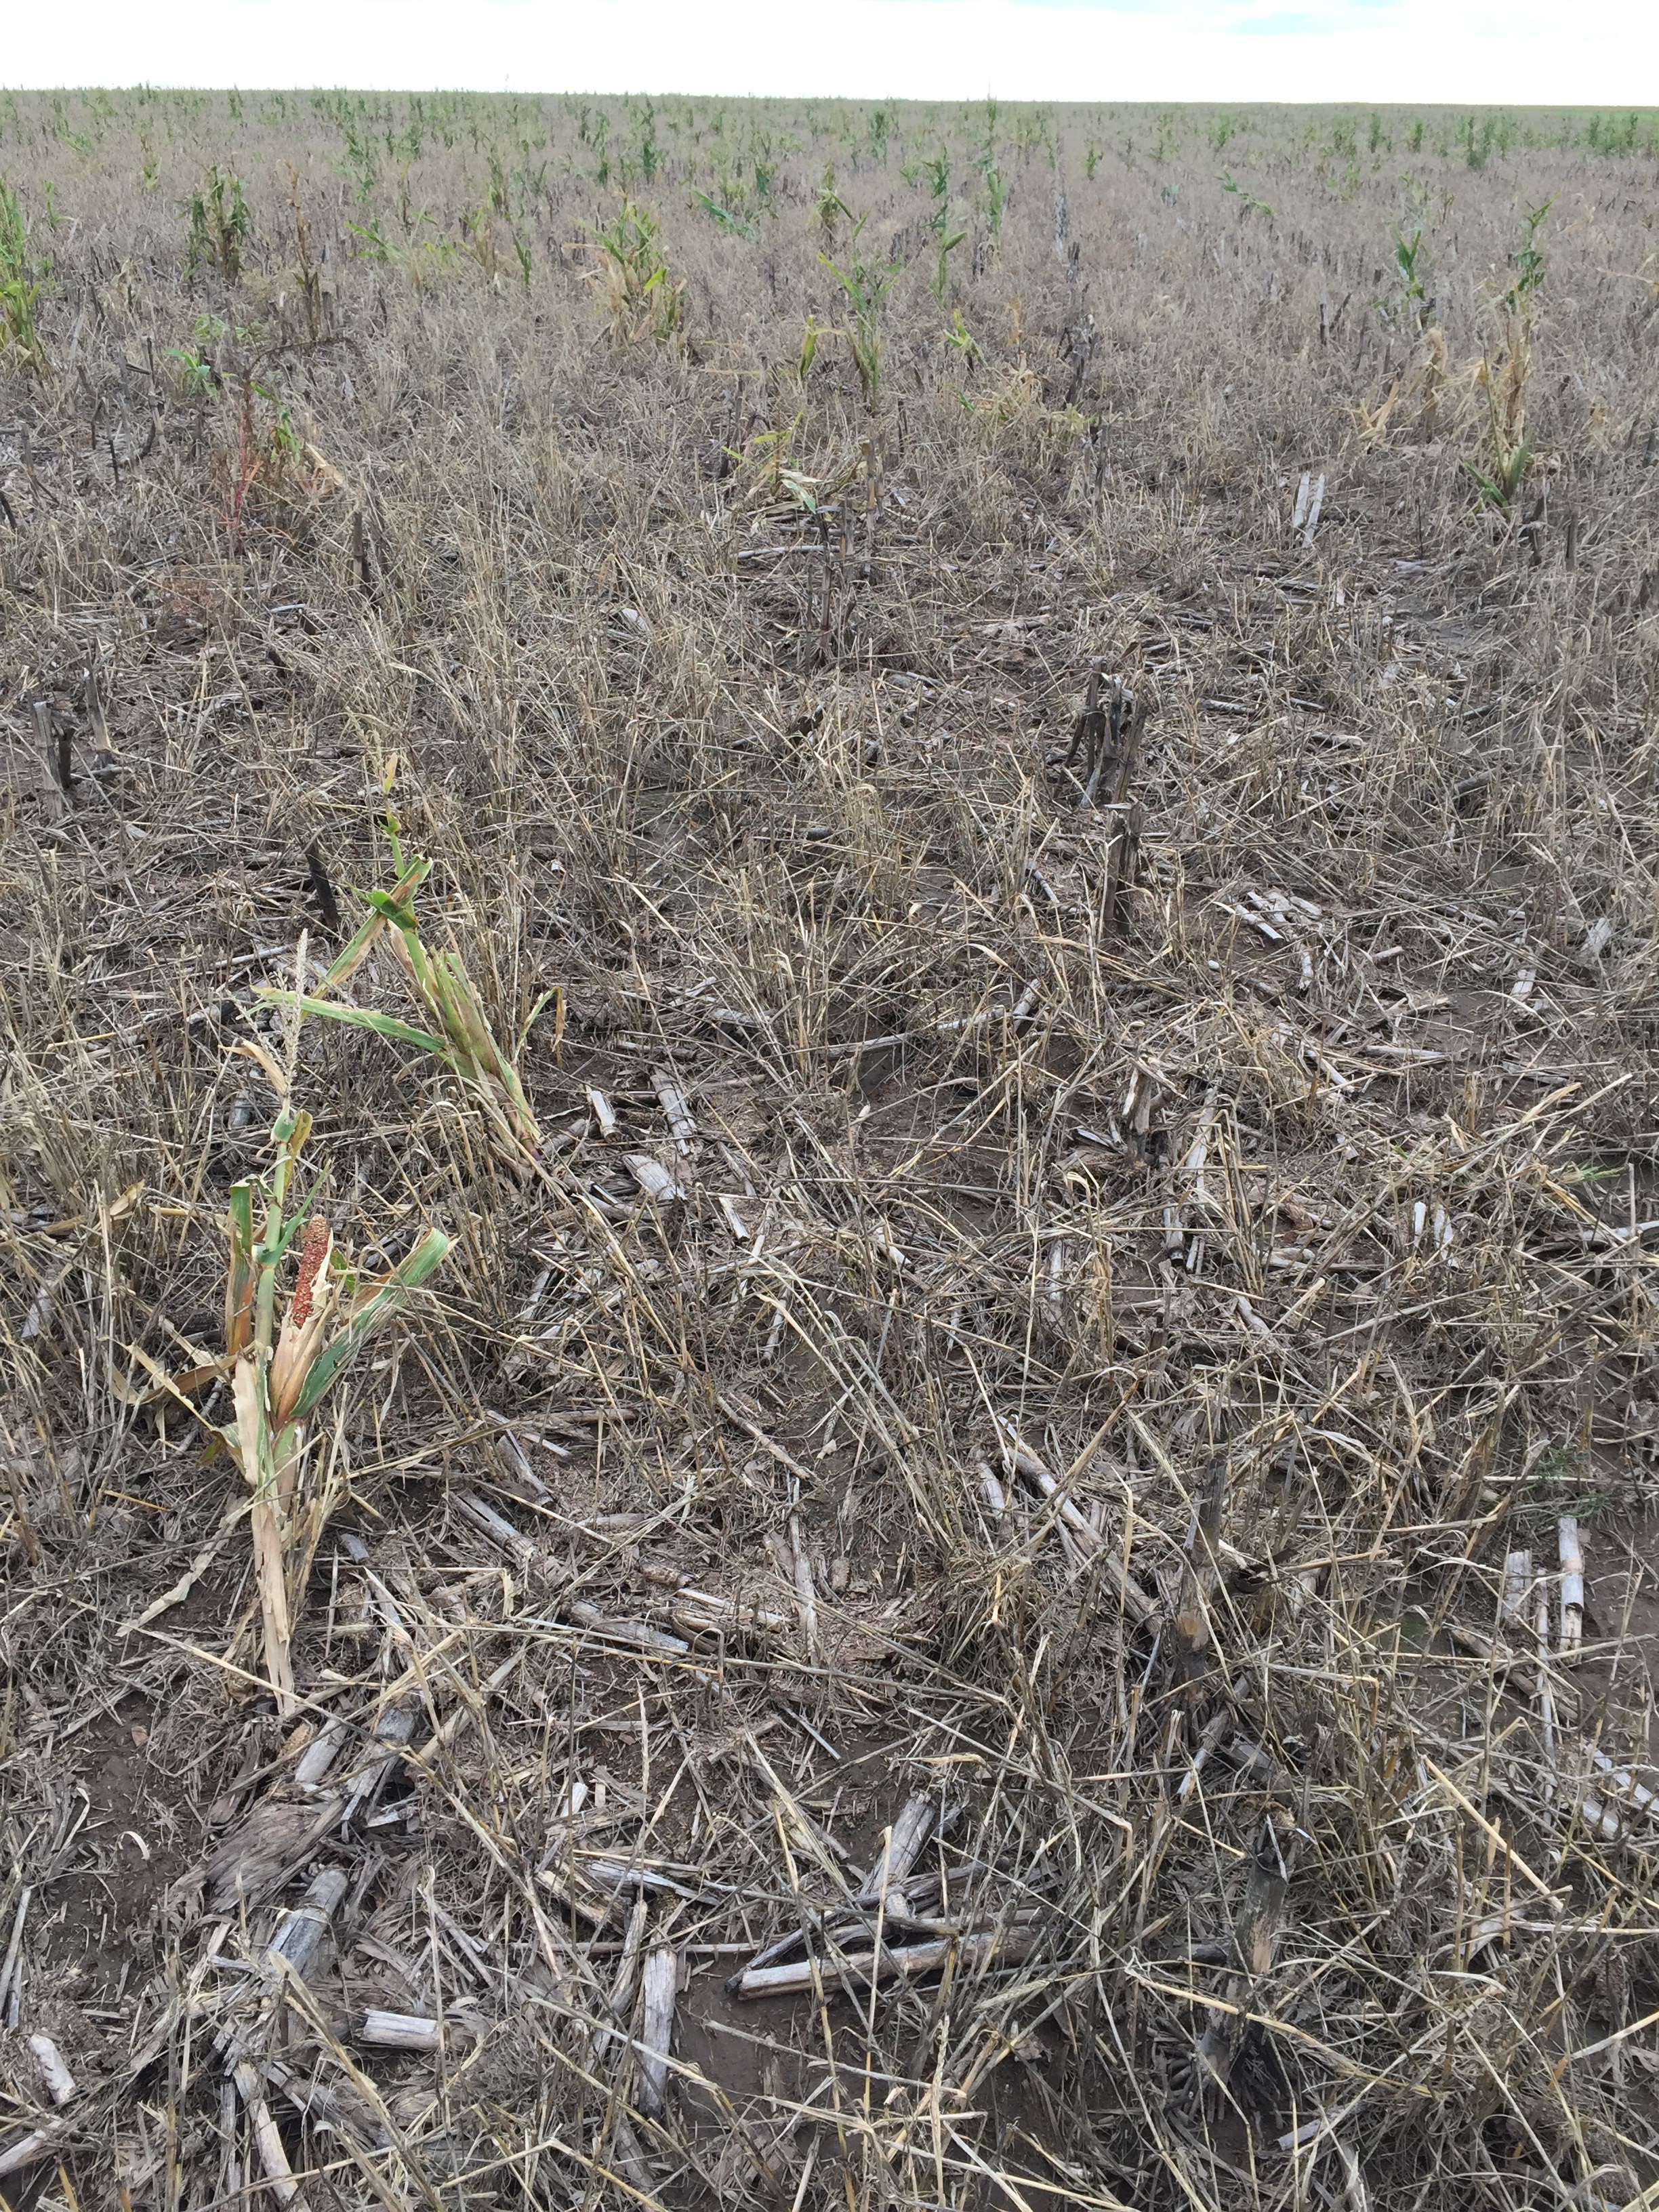
Herbicide
Cons:
Increased use of chemical- which are a disturbance and may upset balance of biology
Expense (cheaper than tillage)?
Concerns with drift
May not be able to spray in wet or windy conditions
If cover is thick may need two applications
Terminating early will reduce available biomass(based on management decisions)
May increase weed resistance to some chemicals
Notes:
Expense- may vary depending on rate and type of chemical. Ask Nathan for spray costs. If weeds are not killed with first application of chemical – such as roundup- these weeds may build up resistance. Generally when there is cover crops that are sprayed out the weeds tend to be in a vegetative stage so chemical is more effective.
What does a quart of roundup cost?

Slide 23
How will you Kill It?
Herbicide…Avoid antagonism!
% control Glyphosate 51%
Consider the modes of action
Mike Plumer
Notes:
Examples of antagonism.. You can hide these depending on your comfort with the subject.
Need notes

Slide 24
How will you Kill It?
Herbicide…Avoid antagonism!
% control Glyphosate 41%
Consider the modes of action
Mike Plumer
Notes:
Example of synergy…You can hide these depending on your comfort with the subject.

Slide 25
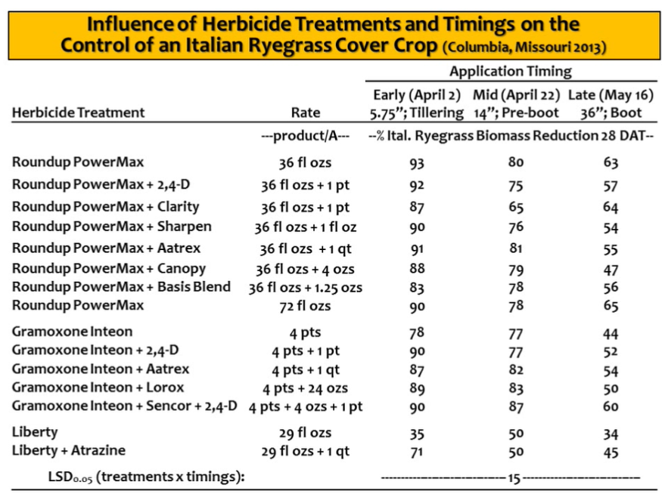
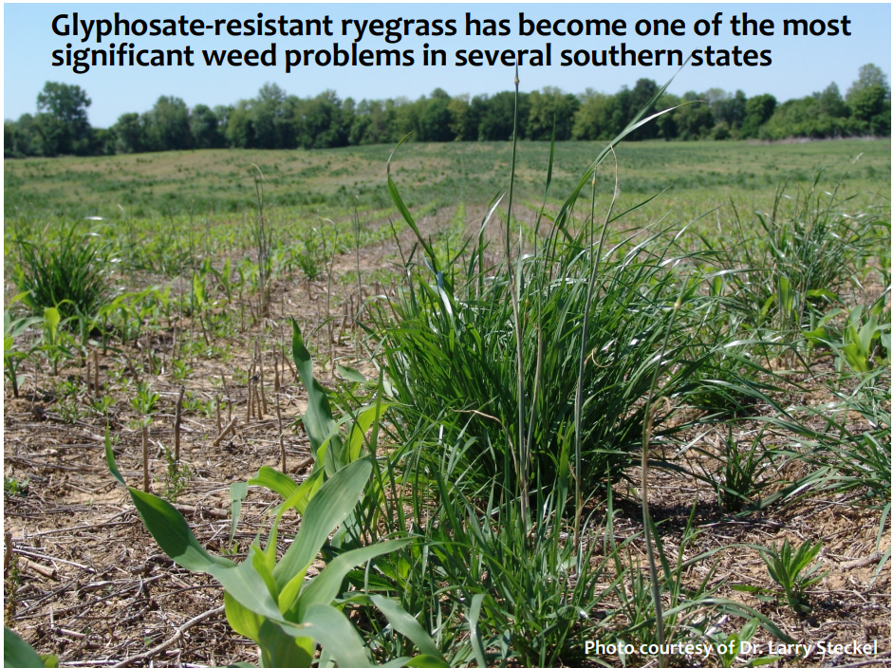
Herbicide considerations for Italian Ryegrass
K. Bradley University of MO
Notes:
Need notes

Slide 26
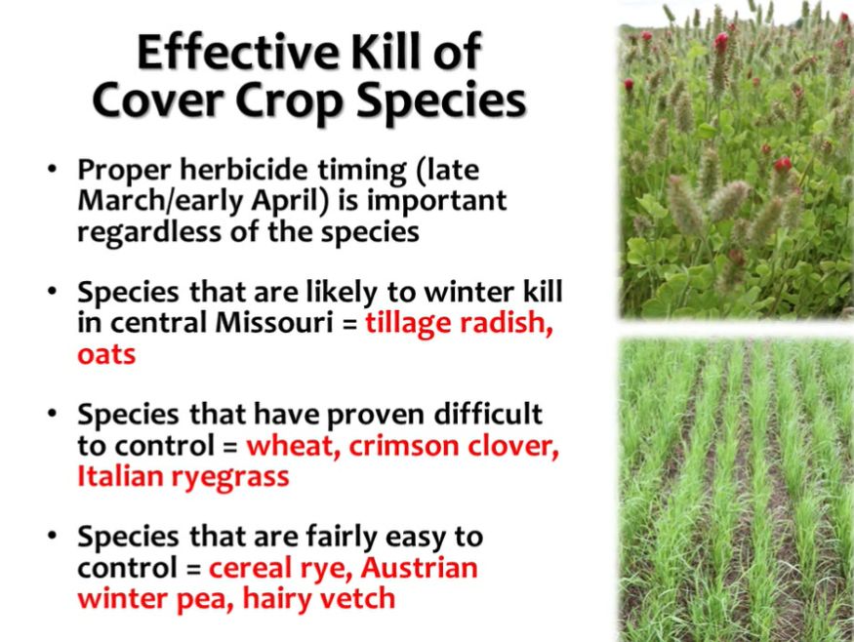
Herbicide Complications
Timing
Temperature
Amount of biomass
K. Bradley U Missouri
Notes:
South of MO they have had issues destroying over wintering brassicas
Need enough daylight
Need enough temperature so plant is actively growing
Informationa from plot work and literature

Slide 27
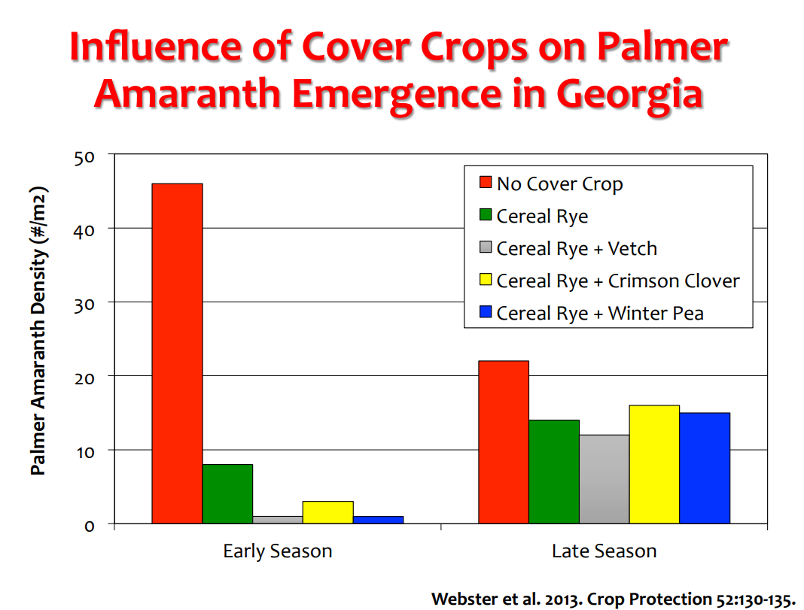

Slide 28
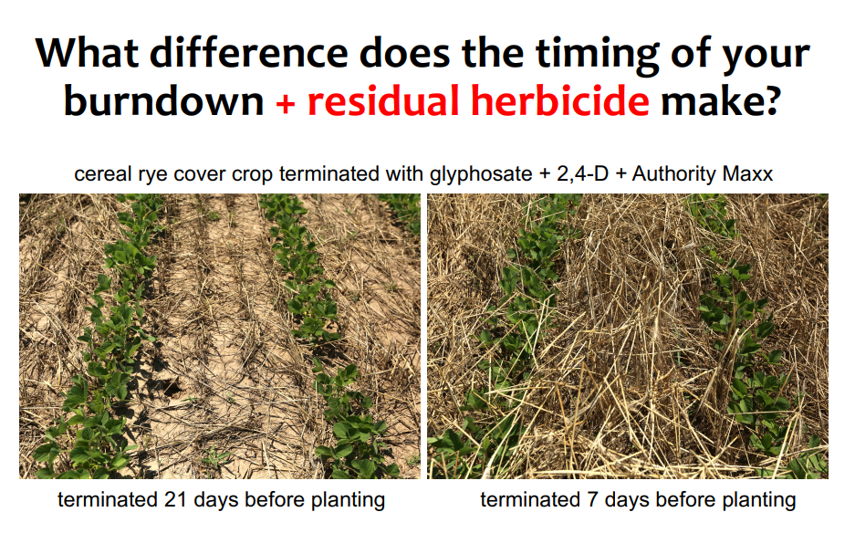
UM Kevin Bradley
Notes:
PRE herbicides were included with the burndown herbicide either 21 or 7 days prior to planting. • Soils were sampled to determine concentrations of sulfentrazone (Authority) in the soil. • Less sulfentrazone concentration occurred where cover crop biomass was highest (inverse relationship to biomass accumulation). • *Take-home: The closer you get to planting, and/or the more biomass your cover crop accumulates, the greater the likelihood that your PRE residual herbicide will not make it to the soil and will not be available for uptake by weed seeds.

Slide 29
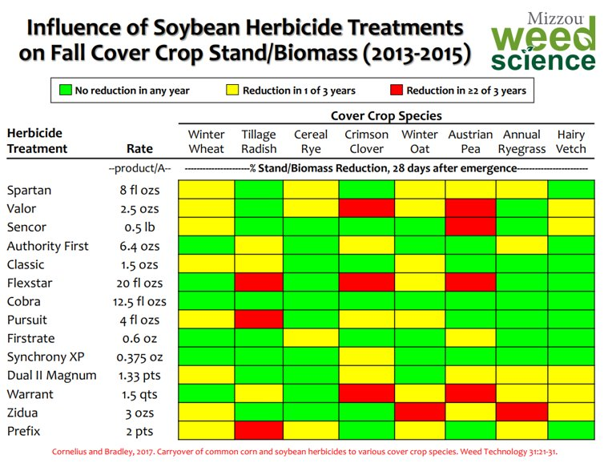
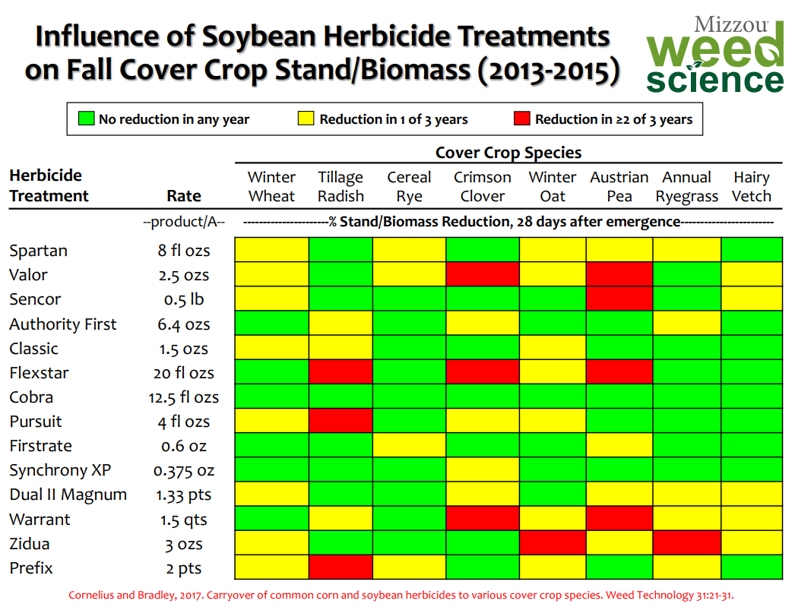
Notes:
Need notes

Slide 30
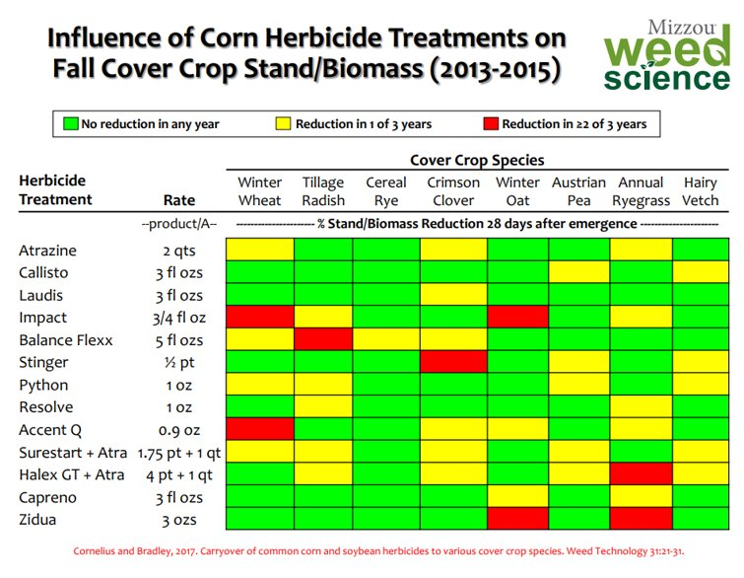
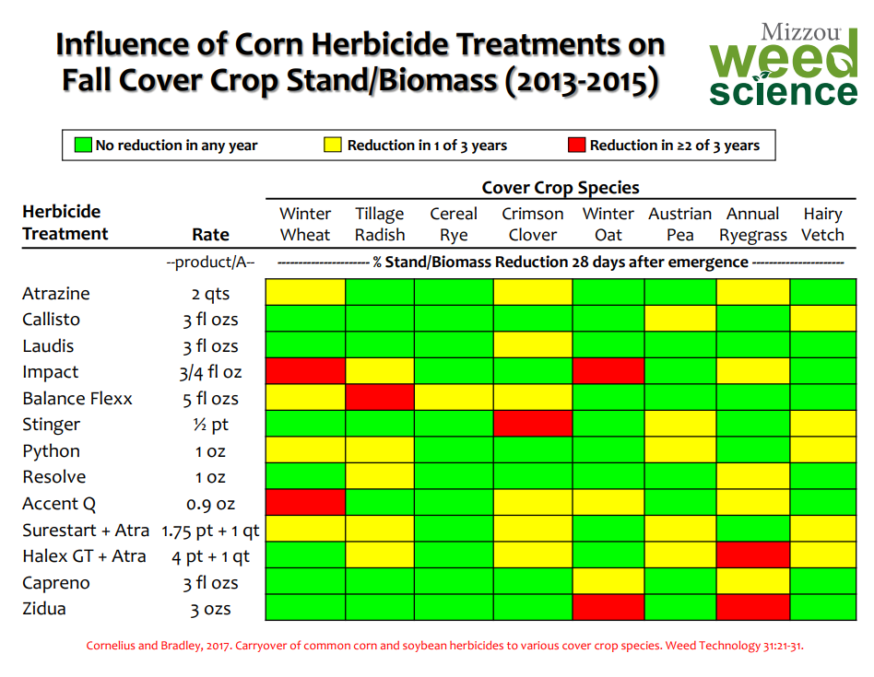

Slide 31
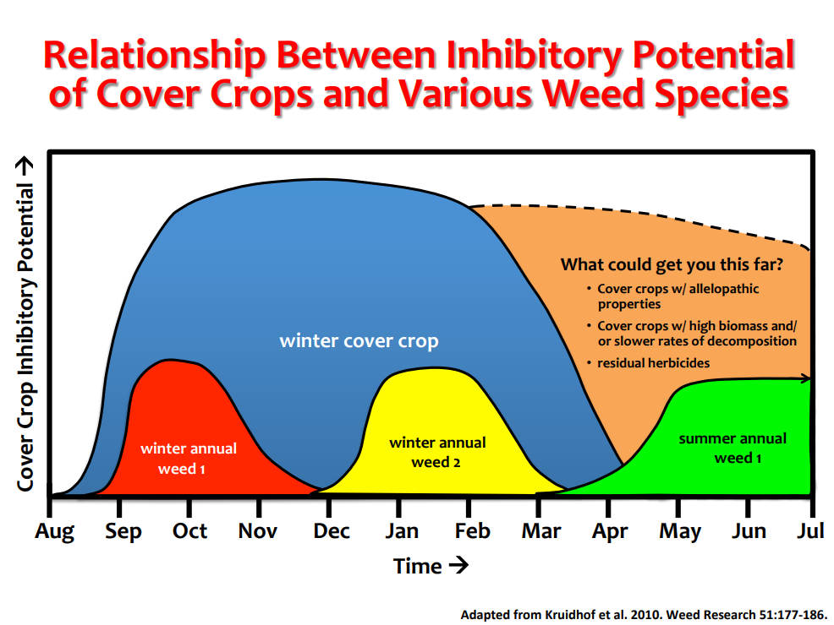
Notes:
What can you do to get the summer annual weed control window?
If they are warm season annuals moving to a cool season crop that would fill that window will diversify the rotation and restrict WS annual outbreaks
Grow more biomass plant commodity crop later

Slide 32
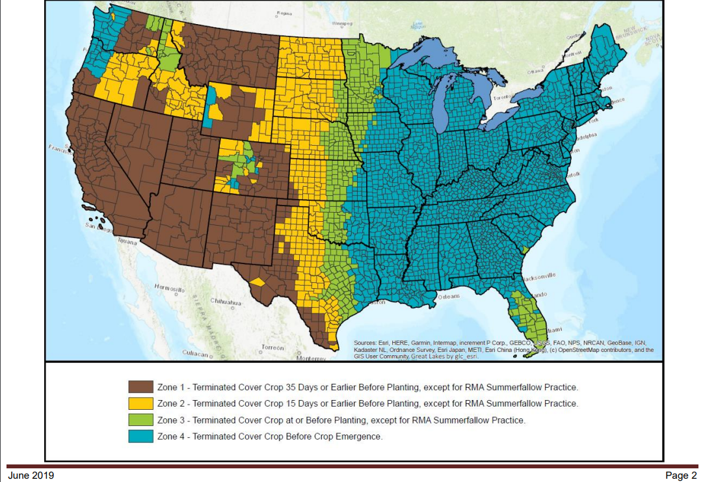
NRCS Termination guidelines
Notes:
Notice the map and the zone designations below. There are dates that apply but there are a lot of caveats. See next slide
Provide handout to class of termination guidelines

Slide 33
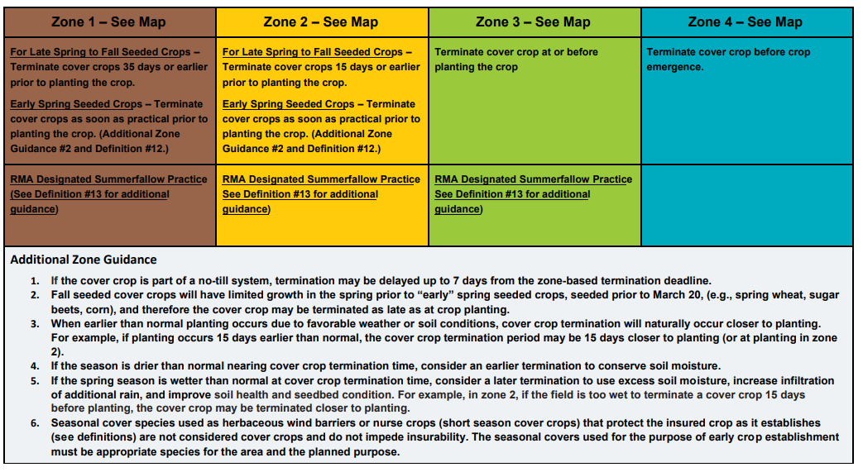
Termination Strategies
Notes:
Most of the time you only see the previous map and the set of dates below it. However, you really need to read this page and determine what type of crop scenario your producer falls under to give good advice.
Are they in a summer fallow practice only zone?
If so does their county offer other practices such as continuous crop?
Be sure to notice special considerations or guidance.
This additional zone guidance can be determined by you according to the state you work in and the Good farming practices handbook which allows NRCS to be “experts”

Slide 34
What is considered a good farming practice?
As defined in the Common Crop Insurance Policy Basic
Provisions, Good Farming Practices means: The production methods utilized to produce the insured crop and allow it to make normal progress toward maturity and produce at least the yield used to determine the production guarantee or amount of insurance, including any adjustments for late planted acreage, which are those generally recognized by agricultural experts or organic agricultural experts, depending on the practice, for the area. An Approved Insurance Provider or a producer may request FCIC be contacted to determine if your production methods will be considered “good farming practices.”

Slide 35
Scenario
My farm is in the bottom righthand corner of SE Colorado. I have irrigation water.
  What is my zone?
  What are my options if I want to plant cereal rye or triticale prior to planting corn?
Notes:
If you are irrigated you do not have to follow the termination guidelines to keep insurance attached to the planted crop.

Slide 36
Scenario
I am in SW Kansas. My county is considered zone 2.
My rotation is wheat sorghum fallow dryland and I no-till.
I want to remove fallow and add cover crops to graze after wheat.
What are my options?
Notes:
The producer can add cover crops to his/her rotation after wheat. They can not hay/graze/or harvest any forage from the cover crop field and still receive summer fallow practice. IF they chose to want to use the cover as a forage then they must get a written agreement and will be switched to continuous crop. If they are content with the rules they are fine. An insurer can not turn down a field for insurance to attach to the crop if cover crops are used this is the difference from previous guidelines. Now the insurer has to prove that a yield loss was evident from the cover crop. If you were to suggest high water use cover crops in your mix you can cause issue with the insured. The cover crops have to have high water use efficiency.
If the producer choses to switch to continuous crop they have the requirement to change their insurance with a written waiver. If they submit the waiver and are just verbally told they didn’t get the waiver that is incorrect. It will be determined by an RMA representative by written letter to the insured if they are approved or not. This only pertains to a grower that is in a summer fallow practice only county. Many or most counties now have the option of continuous cropping as a product they can buy.

Slide 37
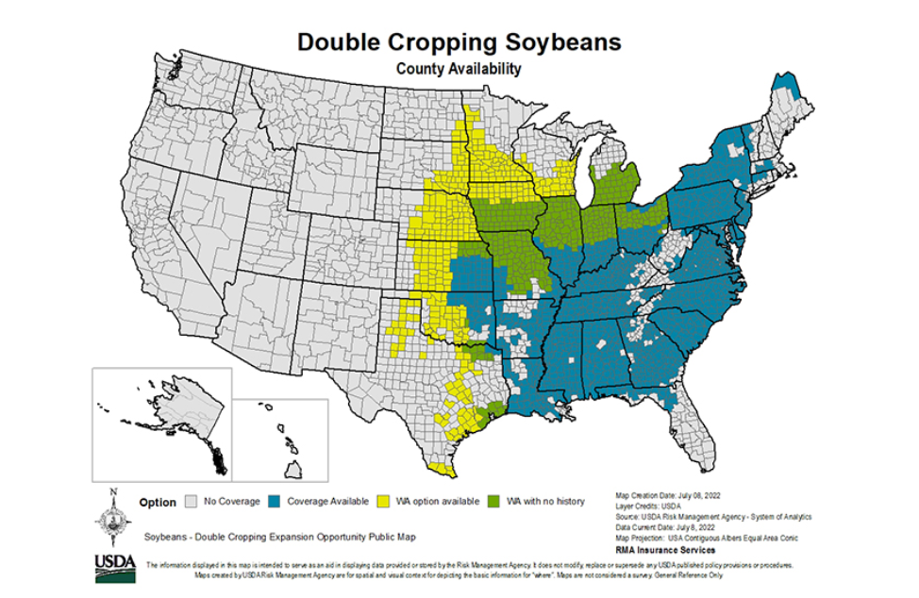
Scenario
I farm in North Carolina.
I have cotton in my rotation and there is little residue left. I would like to have wheat in my rotation along with soybeans.
I could no-till.
I have seen numerous videos on planting green.
What are my options?
Notes:
Well according to this map if this producer wanted to add wheat to his rotation and then double crop soybeans he/she could be eligible for insurance on both crops as opposed to only insurance on the first crop as you see in the green and yellow areas.
After the soybeans are planted they can overseed a cover of cereal rye into that mix and then roll crimp in the spring either after or before planting. NC has a 7days after allowance for getting to terminate covercrops after planting if he/she choses to start farming notill and then the cotton could be planted in to that or they could plant corn. There are numerous options. They could also double crop after an oat or barley crop with grain sorghum. And get coverage for both crops.

Slide 38
Thank you!
For more information on Managing Soil Health,
visit us here:
https://www.nrcs.usda.gov/conservation-basics/natural-resource-concerns/soils/soil-health
USDA is an equal opportunity provider, employer, and lender.

